Slide 1


CAPSTONE PROJECT HEART ATTACK RISK ANALYSIS DASHBOARD
Presented By
Student Name: Krushna Vitthal Rathod
College Name: Yeshwantrao Chavan College of Engineering
Department: AI & Data science
Email ID: krushnarathod0077@gmail.com

Slide 2
OUTLINE:
Problem Statement (Should not include solution)
Proposed System/Solution
System Development Approach (Technology Used)
Algorithm & Deployment
Result (Output Image)
Conclusion
Future Scope
References

Slide 3
Problem Statement:
Heart disease is one of the leading causes of death worldwide. Several factors such as age, lifestyle habits, cholesterol levels, blood pressure, and stress levels contribute to the risk of heart attacks.
Healthcare organizations collect large amounts of patient health data, but analyzing this data manually to identify risk patterns can be difficult and time-consuming.
There is a need for an interactive system that can analyze patient health data and visualize the relationships between different medical and lifestyle factors that contribute to heart attack risk.

Slide 4
Proposed Solution:
The proposed system develops a Heart Attack Risk Analysis Dashboard using Power BI to analyze patient health data and identify key risk factors.
The system performs the following tasks:
Data Analysis: Patient data including age, cholesterol, BMI, blood pressure, smoking habits, and stress levels are analyzed.
Interactive Dashboard: The system visualizes patient health information through charts, graphs, and dashboards.
Risk Pattern Identification: The dashboard highlights relationships between health factors and heart attack risk.
Decision Support: The analysis helps researchers and healthcare analysts better understand patient health patterns.

Slide 5
System Approach:
The project is developed using data visualization and analytics tools.
Tools Used: Power BI Desktop
Dataset Source: Heart Attack Prediction Dataset obtained from Kaggle.
The dataset includes patient health attributes such as:
Data Processing:
The dataset is cleaned and prepared before analysis. This includes:
Checking data types
Creating calculated columns
Creating DAX measures
Removing inconsistencies
Age
Gender
Cholesterol
Blood Pressure
BMI
Smoking
Exercise Hours
Sleep Hours
Stress Level
Heart Attack Risk Indicator

Slide 6
Algorithm & Deployment:
This project focuses on data analytics and visualization rather than predictive modeling.
Data Input
The dataset contains patient health information used to analyze risk patterns.
Analysis Process
Data is imported into Power BI and analyzed using DAX calculations and visual analytics techniques.
Measures such as total patients and high-risk patients are calculated.
Visualization
Several charts are used for analysis including:
Smoking vs Heart Attack Risk
Exercise vs Risk
Cholesterol vs Heart Rate
BMI vs Risk
Blood Pressure Distribution
Deployment
The dashboard can be shared using:
Power BI Desktop Power BI Service for online reporting

Slide 7
Result:
The dashboard successfully visualizes important health factors related to heart attack risk.
Key insights obtained from the dashboard include:
High cholesterol levels are associated with increased heart attack risk.
Smoking habits significantly increase the likelihood of heart disease.
Patients with higher stress levels show greater risk patterns.
Overweight and obese BMI categories have higher heart attack probability.
The interactive dashboard allows users to explore patient health data using filters and visual analysis.

Slide 8
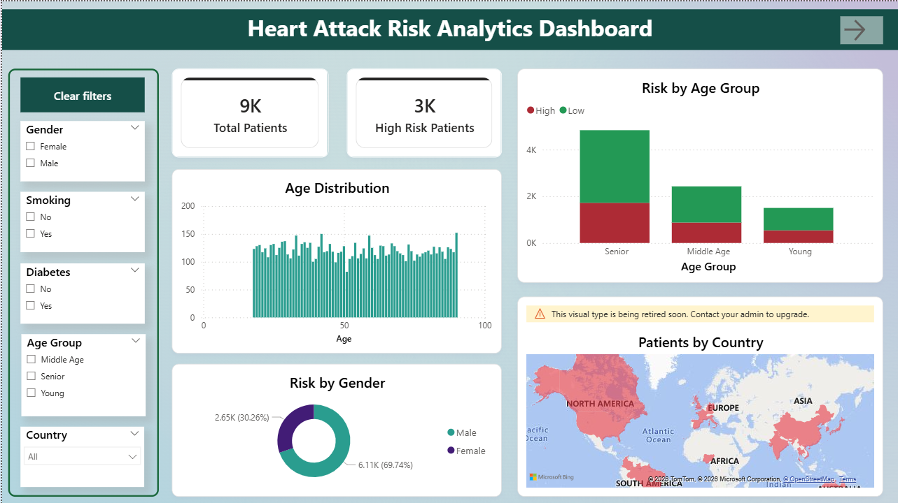
Screenshot:

Slide 9
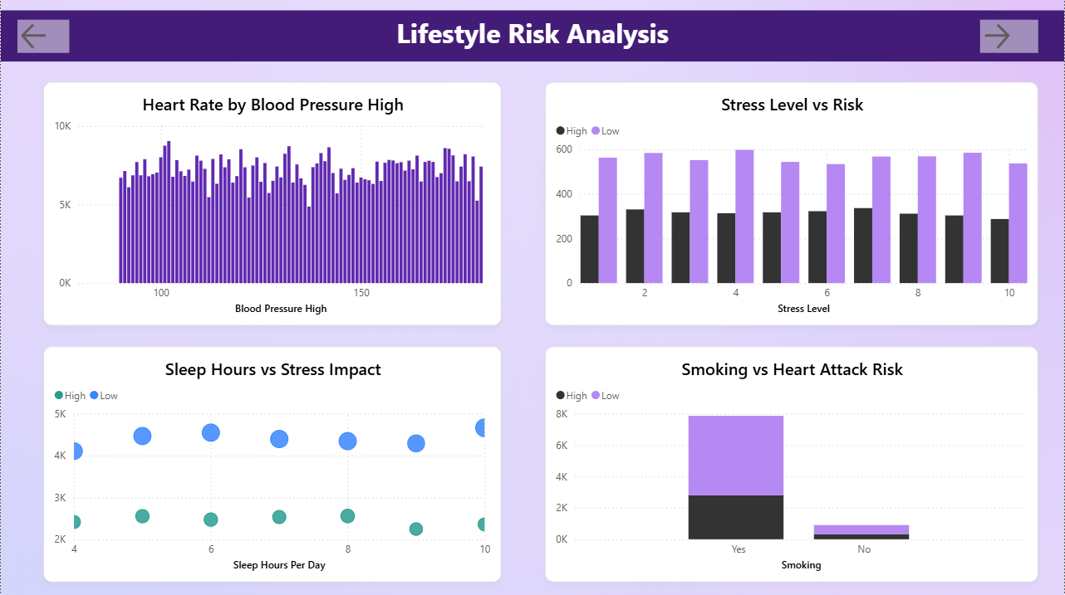
Screenshot:

Slide 10
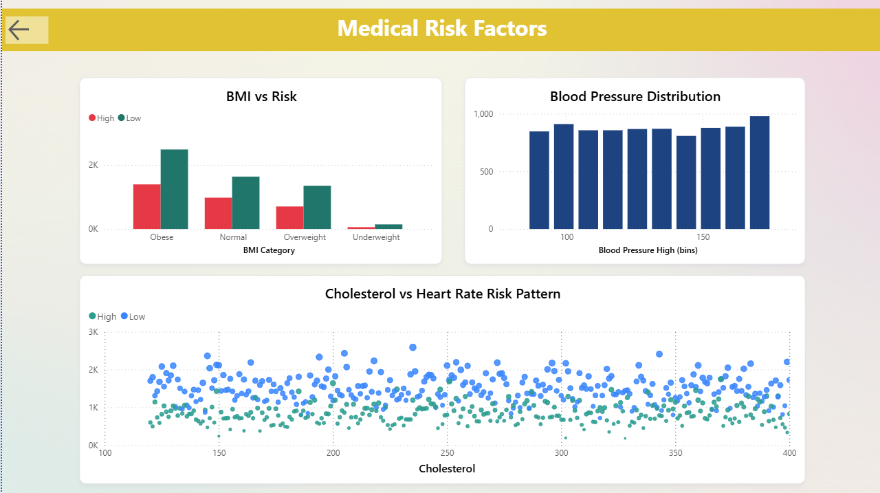
Screenshot:

Slide 11
Conclusion:
The Heart Attack Risk Analysis Dashboard provides an effective way to analyze healthcare data and identify important health risk factors.
By transforming complex datasets into clear visualizations, the dashboard helps users understand how different medical and lifestyle factors influence heart attack risk.
This project demonstrates how data analytics tools like Power BI can support healthcare data analysis and improve understanding of disease risk patterns.

Slide 12
Future scope:
The project can be improved in several ways:
Integrating larger healthcare datasets
Adding real-time health monitoring data
Developing predictive models for heart attack risk
Creating a web-based healthcare analytics system
Expanding analysis for multiple diseases
These improvements could enhance the system’s ability to support healthcare research and decision-making.

Slide 13
References:
Kaggle Dataset Heart Attack Prediction Dataset https://www.kaggle.com/datasets/iamsouravbanerjee/heart-attack-prediction-dataset
Microsoft Power BI Documentation https://learn.microsoft.com/power-bi/
Healthcare analytics research articles.
GitHub Link:Github Link

Slide 14
Thank You

